Slide 1
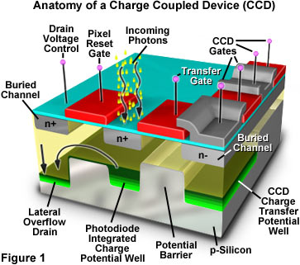

Slide 2
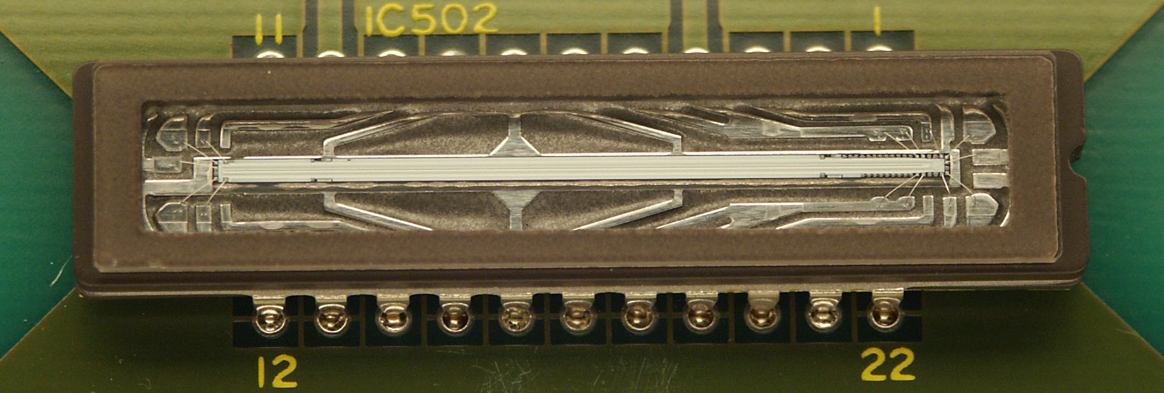

Slide 3
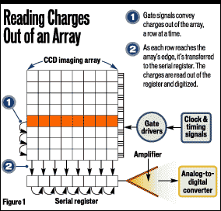

Slide 4
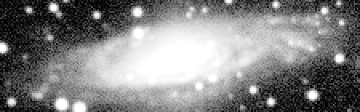
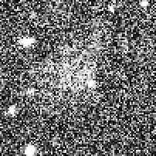

Why Astronomers Love CCDs:
High QE compared to photographic media
High Linearity
Large Dynamic Range
Fairly Uniform Response
Relatively Low Noise
Its Digital !

